Slide 1

SWD 392 - Software Architecture and Design

Slide 2
Use Case Modeling
SWD392

Slide 3
01
Table of Contents
REQUIREMENTS MODELING
04
IDENTIFYING USE CASES
02
USE CASES
05
DOCUMENTING USE CASES IN THE USE CASE MODEL
03
ACTORS
06
EXAMPLE OF USE CASE DESCRIPTION
07
USE CASE RELATIONSHIPS

Slide 4
08
Table of Contents
THE INCLUDE RELATIONSHIP
11
SPECIFYING NONFUNCTIONAL REQUIREMENTS
09
THE EXTEND RELATIONSHIP
12
USE CASE PACKAGES
10
USE CASE STRUCTURING GUIDELINES
13
ACTIVITY DIAGRAMS

Slide 5
01
REQUIREMENTS MODELING

Slide 6
REQUIREMENTS MODELING
Requirements Analysis:
The software requirements describe the functionality that the system must provide for the users. Requirements analysis involves analyzing the requirements
Requirements Specification:
After the analysis, the requirements need to be specified. The requirements specification is the document that needs to be agreed on by the requirements analysts and the users. It is the starting point for the subsequent design and development, so it must also be understood by the developers. Both functional requirements and nonfunctional requirements need to be specified
Quality Attributes of Software Requirements Specification
- Correct - Verifiable
- Complete - Understandable by non-computer specialists.
- Unambiguous - Modifiable
- Consistent - Traceable

Slide 7
USE CASES
02

Slide 8
USE CASES
In the use case modeling approach, functional requirements are described in terms
of actors, which are users of the system, and use cases. A use case defines a sequence
of interactions between one or more actors and the system. In the requirements
phase, the use case model considers the system as a black box and describes the
interactions between the actor(s) and the system in a narrative form consisting
of user inputs and system responses. The use case model describes the functional
requirements of the system in terms of the actors and use cases. The system is treated
as a black box – that is, dealing with what the system does in response to the actor’s
inputs, not the internals of how it does it.

Slide 9
USE CASES
A Simple Use Case
The essentials of the use case description consist of
the following:
■ The name of the use case, View Alarms.
■ The name of the actor, Monitoring Operator.
■ A one-sentence use case summary, which provides a brief description.
■ The description of the main sequence of events. For this use case, the first step
is the operator request and the second step is the system response.
■ The description of any alternative to the main sequence. For this use case, there
could be an alternative at step 2, which would be executed if there is a monitoring
emergency.

Slide 10
ACTORS
03

Slide 11
USE CASES
• Actor models external entities of system
• Actors interact directly with system Actors interact directly with system
– Human user
– External I/O device
– External system
– Timer
• Actor initiates actions by system
– May use I/O devices or external system to physically
interact with system
– Actor initiates use cases

Slide 12
IDENTIFYING USE CASES
04

Slide 13
01
IDENTIFYING USE CASES
To determine the use cases in the system, it is useful to start by considering the actors and the interactions they have with the system.
Each use case describes a sequence of interactions between the actor and the system.
In this way, the functional requirements of the system are described in terms of the use cases, which constitute functional specification of a system.
However, when developing use cases, it is important to avoid a functional decomposition in which several small use cases describe small individual functions of the system rather than describe a sequence of events that provides a useful result to the actor
04
02
05
03

Slide 14
01
IDENTIFYING USE CASES
In addition to withdrawing cash from the ATM, the ATM Customer actor is also allowed to query an account or transfer funds between two accounts.
Because these are distinct functions initiated by the customer with different useful results, the query and transfer functions should be modeled as separate use cases, rather than being part of the original use
case
04
02
05
03

Slide 15
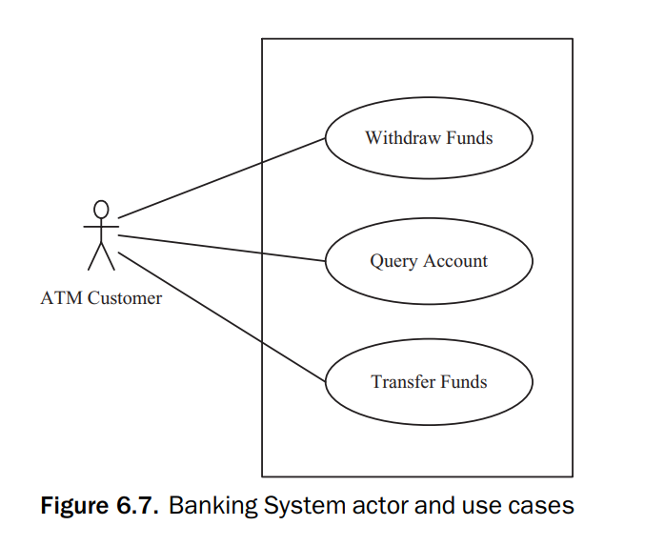
01
IDENTIFYING USE CASES
04
02
05
03
06
07
Thus, the customer can initiate three use cases, as shown in Figure 6.7: Withdraw Funds,
Query Account, and Transfer Funds.

Slide 16
05
DOCUMENTING USE CASES IN THE USE CASE MODEL

Slide 17
01
IDENTIFYING USE CASES
Use case name: Each use case is given a name.
Summary: A brief description of the use case, typically one or two sentences.
Dependency: This optional section describes whether the use case depends
on other use cases – that is, whether it includes or extends another use case.
Actors: This section names the actors in the use case. There is always a primary actor that initiates the use case. In addition, there may be secondary
actors that also participate in the use case. For example in the Withdraw
Funds use case, the ATM Customer is the only actor
Preconditions: One or more conditions that must be true at the start of use
case, from the perspective of this use case; for example, the ATM machine
is idle, displaying a “Welcome” message.
04
02
05
03

Slide 18
01
IDENTIFYING USE CASES
Description of main sequence: The bulk of the use case is a narrative
description of the main sequence of the use case, which is the most usual
sequence of interactions between the actor and the system. The description
is in the form of the input from the actor, followed by the response of the
system.
Description of alternative sequences: Narrative description of alternative
branches off the main sequence. There may be several alternative branches
from the main sequence. For example, if the customer’s account has insufficient funds, display apology and eject card. The step in the use case at which
the alternative sequence branches off from the main sequence is identified
as well as a description of the alternative
04
02
05
03

Slide 19
01
IDENTIFYING USE CASES
Nonfunctional requirements: Narrative description of nonfunctional
requirements, such as performance and security requirements.
Postcondition: Condition that is always true at the end of the use case (from
the perspective of this use case) if the main sequence has been followed; for
example, customer’s funds have been withdrawn.
Outstanding questions: During development, questions about the use case
are documented for discussions with users.
04
02
05
03

Slide 20
06
EXAMPLE OF USE CASE DESCRIPTION

Slide 21
01
IDENTIFYING USE CASES
04
In the main sequence of the Make Order Request use case, the customer makes an order request to purchase items from an online catalog and has sufficient credit to pay for the items
The alternative sequences deal with other situations, which occur less frequently: the customer has no account and has to create one, or the customer has an invalid credit card
02
05
03

Slide 22
USE CASE RELATIONSHIPS
07

Slide 23
01
The Use Case Relashionships
04
When use cases get too complex, dependencies between use cases can be defined by using the include and extend relationships.
Inclusion use cases are determined to identify common sequences of interactions in several use cases, which can then be extracted and reused.
Use case generalization is similar to the extend relationship because it is also used for addressing variations.
Use case variations can be adequately handled by the extend relationship.
02
05
03
06
07

Slide 24
08
THE INCLUDE
RELATIONSHIP

Slide 25
01
The Inlude Relationship
04
A common sequence of interactions can be extracted from several of the original use cases and made into a new use case, which is called an inclusion use case.
It is then possible to define a more concise version of the old use case, with the common interaction sequence removed. This concise version of the old use case is referred to as a base use case (or concrete use case), which includes the inclusion use case.
Inclusion use cases always reflect functionality that is common to more than one use case.
02
05
03
06
07

Slide 26
THE EXTEND
RELATIONSHIP
09

Slide 27
01
The Extend Relationship
04
The extend relationship is used to model alternative paths that a use case might take.
The use case that is extended is referred to as the base use case, and the use case that does the extending is referred to as the extension use case.
The extend relationship can be used as follows:
To show a conditional part of the base use case that is executed only under certain circumstances
To model complex or alternative paths.
02
05
03
06
07

Slide 28
10
USE CASE STRUCTURING GUIDELINES

Slide 29
01
Careful application of use case relationships can help with the overall organization of the use case model; however, use case relationships should be employed judiciously.
It should be noted that small inclusion use cases corresponding to individual functions (such as Dispense Cash, Print Receipt, and Eject Card) should not be considered.
These functions are too small, and making them separate use cases would result in a functional decomposition with fragmented use cases in which the use case descriptions would be only a sentence each and not a description of a sequence of interactions.
The result would be a use case model that is overly complex and difficult to understand – in other words, a problem of not being able to see the forest (the overall sequence of interactions) for the trees (the individual functions)!
04
02
05
03
06
07

Slide 30
11
SPECIFYING NONFUNCTIONAL REQUIREMENTS

Slide 31
01
Nonfunctional requirements can be specified in a separate section of the use case description, in much the same way that alternative sequences are specified.
For example, for the Validate PIN use case, there could be a security requirement that the card number and PIN must be encrypted. There could also be a performance requirement that the system must respond to the actor inputs within 5 seconds. If the nonfunctional requirements apply to a group of related use cases, then they can be documented as such, as described in the next section.
04
02
05
03
06
07

Slide 32
12
USE CASE PACKAGES

Slide 33
01
For large systems, having to deal with a large number of use cases in the use case model often gets unwieldy.
A good way to handle this scale-up issue is to introduce a use case package that groups together related use cases. In this way, use case packages can represent high-level requirements that address major subsets of the functionality of the system.
Nonfunctional requirements that apply to a group of related use cases could be assigned to the use case package that contains those use cases.
04
02
05
03
06
07

Slide 34
13
ACTIVITY DIAGRAMS

Slide 35
01
An activity diagram is a UML diagram depicting the flow of control and sequencing among activities.
An activity diagram shows the sequence of activities, decision nodes, loops, and even concurrent activities. Activity diagrams are widely used in workflow modeling – for example, for service-oriented applications.
04
02
05
03
06
07

Slide 36
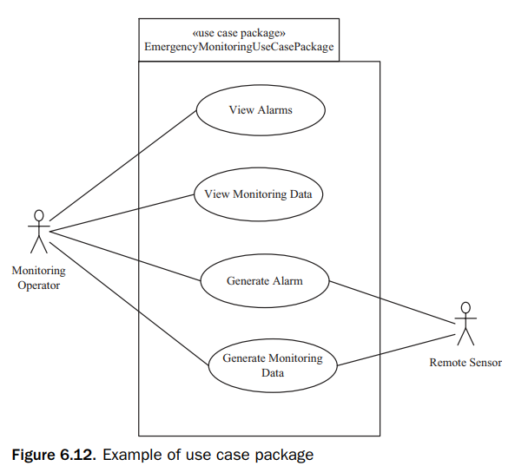
01
04
02
05
03
06
07

Slide 37
01
A use case model can also be described using an activity diagram. However, to depict a use case, a subset of the activity diagram capabilities is sufficient.
An activity diagram can be used to represent the sequential steps of a use case, including the main sequence and all the alternative sequences. An activity node can be used to represent one or more sequential steps of the use case. A high-level activity node can be used to represent a use case, which can then be decomposed into a separate activity diagram. Activity diagrams can also be used to depict sequencing among use cases.
04
02
05
03
06
07

Slide 38
01
For depicting a use case, an activity diagram uses activity nodes, decision nodes, arcs to join sequential activity nodes, and loops. An activity node is used to depict one or more steps in the use case description. A decision node is used to depict a situation in which, based on the result of the decision, an alternative sequence could branch off from the main sequence.
Activity nodes can be aggregate nodes that are hierarchically decomposed to give a lower-level activity diagram. This concept can be used to depict inclusion and extension use cases. Thus, an activity node in a base use case can be used to represent a link to an inclusion (or extension) use case, which is then depicted on a separate lower-level activity diagram.
04
02
05
03
06
07

Slide 39
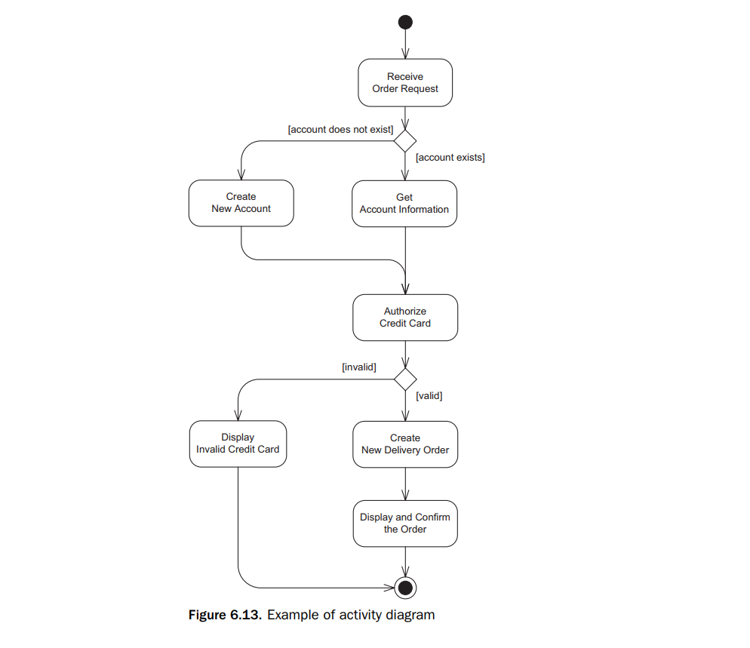
01
04
02
05
03
06
07

Slide 40
Thanks!

